Slide 1
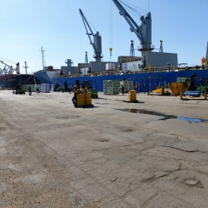
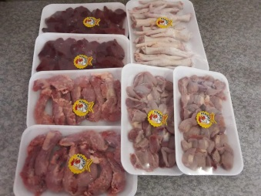
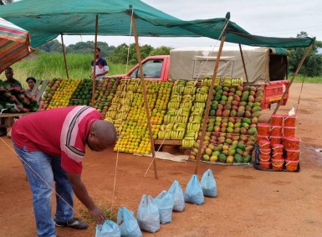
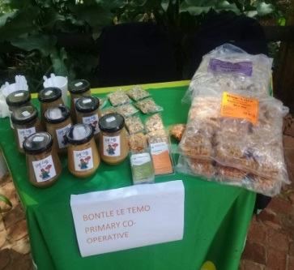
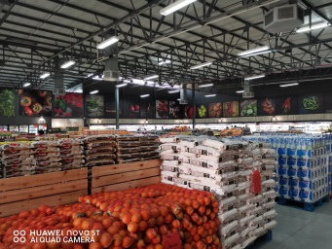
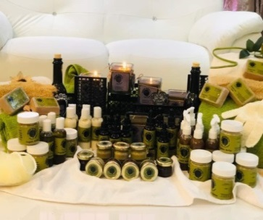

MARKET ACCESS VIRTUAL WEBINAR
SPS-TBT Matters Relative to Market Access of Agricultural and Agroprocessed Products
By Mr Mpho Sekgala 18 August 2021
Directorate: Food Import and Export Standards

Slide 2
Presentation Outline …..
Introduction
National Policies and programmes
Comprehensive value chain support
Key role players in the market access for agricultural and agroprocessed products
International SPS/ TBT framework
National legislative framework in the market access environment for agric and agroprocessed products
Summary of the legislation application scope per product type and role players involved
Services offered by the department with regard to market access
Some of the export markets
Challenges in the animal and processed products
Challenges in the plant health environment
What is to be done?
Transformation in the sector

Slide 3
Introduction ..…
Market access refers to the ability of a company or country to sell goods and services across borders. Market access can be used to refer to domestic trade as well as international trade, although the latter is the most common context.
Smallholder farmers and food processors have potential to grow the economy through participation in the mainstream agriculture value chain;
Majority of the smallholder farmers and emerging food processors are battling to comply with SPS/TBT standards;
SPS/ TBT Standards play a critical role in the market access environment; and
Market access challenge is raised in many of the agricultural sessions.

Slide 4
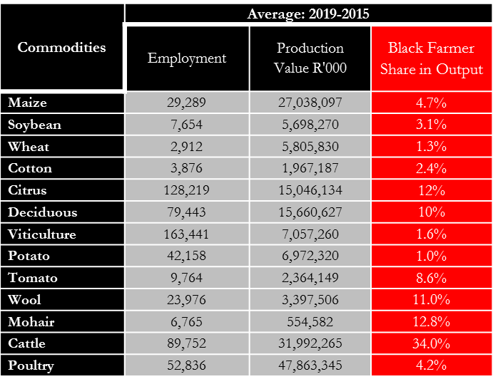
Introduction ..…
Average: 2015 - 2019

Slide 5
National Policies and Programme .….
National Development Plan (NDP);
National Growth Path;
National Industrial Policy Framework;
Industrial Policy Action Plan (IPAP);
Medium-Term Strategic Framework;
National Infrastructure Plan Strategic Integrated Project (SIP-11);
Agriculture Policy Action Plan (IPAP);
Operation Phakisa;
Sugar Master Plan;
Agriculture and Agro-processing Poultry Master Plan;
Policy on Comprehensive Producer Development Support (under discussion); and
Agricultural & Agro-processing Master Plan (under discussion).

Slide 6
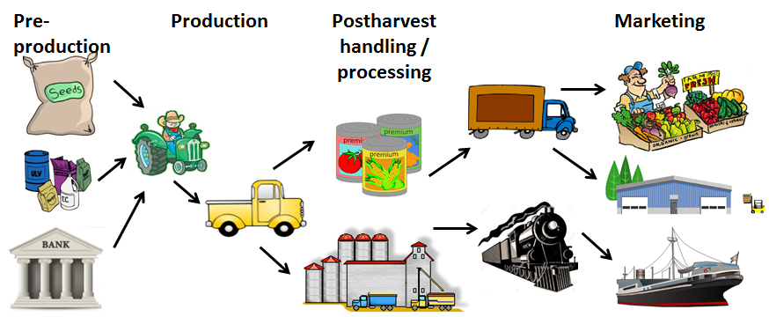

Comprehensive Value Chain Support ………
Extension and Advisory Service
Marketing support
Business Dev. Support
Subsidised loans
Sanitary & Phytosanitary measures / Effective Biosecurity System with proper structures at relevant spheres
Business Planning
Access to resources (i.e. land, water etc.)
Conditional Disaster Relief
Production inputs
Subsidised insurance
On and Off-farm infrastructure
Mechanisation

Slide 7
Key role players in the market access for agricultural and agro-processed products
Department of Agriculture, Land Reform ad Rural Development
  Agricultural Production, Health and Food Safety Branch
    The National SPS Committee , Citrus Coordinating Meeting, Deciduous Coordinating meeting, Import and Export Forum for animal and animal products,
  Chief Directorate: Agroprocessing, Marketing and Rural Industrial Development (AMRID)
  Chief Directorate: International Relations and Trade
The dtic & National TBT committee;
DoH & DEFF;
DIRCO;
Provincial Departments of Agriculture;
National Agricultural Marketing Council;
Agricultural Business Chamber;
International Trade Administration Commission of South Africa (ITAC);
Farmers Organizations; and
Commodity groups, farmers associations (e.g. cotton, grains, meat, fruits, flowers).

Slide 8
Market Access

Slide 9
International SPS / TBT Framework
WTO
Technical Barriers to Trade Agreement (TBT)
Sanitary and Phytosanitary Agreement (SPS)
Technical Regulations
International Plant Protection
Convection (IPPC)
Codex Alimentarius Commission
OIE (World Org for Animal Health)
Covers the following
Exotic pest/s/diseases of plants
Phytosanitary market access
requirements
Import and export control of
plants and plants products &
Management of import export
programmes
Covers the following
Additives
Contaminants
Toxins
Foodborne diseases
Labelling, packaging, grading
Market access standards
Food safety and quality, certification
Safe use of agrochemicals
Covers the following
Control of zoonotic/
Notifiable/controlled disease
Sanitary market access requirements
Phytosanitary
Food Safety, Quality & TBT
Animal Health
Protect
Human Life
Protect
Animal Life
Protect
Plant Life
Protect
Our Country

Slide 10
National Legislative framework in the market access environment for agric and agroprocessed products
Agricultural Pests Act, 1983 (Act No. 36 of 1983);
Agricultural Produce Agents Act, 1992 (Act No.12 of 1992);
Agricultural Product Standards Act, 1990 (Act No. 119 of 1990);
Animal Diseases Act, 1984 (Act No. 35 of 1984);
Fertilizers, Farm Feeds Agricultural Remedies and Stock Remedies, 1947 (Act No. 36 of 1947);
Liquor Products Act, 1989 (Act No. 60 of 1989);
Meat Safety Act, 2000 (Act No. 40 of 2000);
Marketing of Agricultural Products Act, 1996 (Act No. 47 of 1996);
Perishable Products Export Control Act, 1983 (Act No. 9 of 1983);
The Foodstuffs, Cosmetics and Disinfectants Act, 1972 (Act No. 54 of 1972);
The Health Act, 1977 (Act No. 63 of 1977);
The Medicines and Related Substances Act, 1965 (Act No. 101 of 1965);
The Hazardous Substances Act, 1975 (Act No. of 1975);
The Trade Metrology Act, 1973 (Act No. 77 of 1973);
Trade Marks Act, 1963 (Act No. 62 of 1963); and
The Consumer Protection Act, 2008 (Act No. 68 of 2008).

Slide 11
Summary of the legislation application scope per product type and role players involved …………..
Product type | Some of SPS/ TBT issues for consideration | Some of the role players to consider for collaborations | Example of some of the legislations
Plant and plant products | Food safety and quality regs Phytosanitary regs (IPM, GAP), SAGAP ISO/ FSSC 22000 HACCP SOPs, Performance Stds etc | DAFF DAFF/PDA + consider literature on IPM & GAP PPECB and other assignees SEDA Accredited service providers Industry | Agricultural Product Stds Act FFFARSR (Act 36) Agric Pests Act 36 of 1983 Private International Stds Trade Metrology Act
Animal and animal products | Food safety and quality regs Biosecurity measures Hygiene practices SOPs, Performance Stds HACCP ISO/ FSSC 22000 | DAFF, DoH, Private sector DAFF/PDA , PPCEB DoH and other international Stds NRCS, CGCSA Assignees | Agricultural Product Stds Act Meat Safety Act , FFFARSR (Act 36) Animal Disease Act Foodstuffs , Cosmetic and Disinfectant Act No 54 of 1972 Trade Metrology Act
Agroprocessing | Food safety and quality Hygiene and other health regs ISO/ FSSC 22000 IPM, GMP and SOPS Barcodes , Certificate of Acceptance | DAFF, NRCS, SABS DoH /PDAs/ Municipalities Accredited service provider Establishment Consumer Assignees | Agricultural Product Stds Act Meat Safety Act Animal Disease Act Foodstuffs , Cosmetic and Disinfectant Act No 54 of 1972 Trade Metrology Act
Hygiene, safe use of agrochemicals, Quality/ grading, packaging, labelling , packing , food safety, GAP and IPM, GMP are critical areas of focus

Slide 12
Services offered by the department with regard to market access ……
Generate legislations for compliance at country level;
Generate trade balance sheet;
Render inspection services;
Appoint and manage assignees;
Participate in the negotiations of international markets/ trade agreements;
Generate and maintain export protocols;
Generate legislations for national markets, imports and export;
Issue phytosanitary certificates , animal health certificates and import permits;
Maintenance of the biosecurity system (manage pests and diseases etc.);
Conduct pest risk analysis;
Certify establishments like abattoirs; and
Lead the National SPS Committee and Coordinating meetings etc.
11

Slide 13
Some of the export markets …..
Export of vegetables that require phytosanitary registration | Export of vegetables that do not require phytosanitary registration
Capsicum L. (Capsicum: pepper / chili) Momordica L. (bitter melon) Solanum aethiopicum L. (“Christmas aubergine”) Solanum macrocarpon L. (“African aubergine”) Solanum melongena L. (aubergine) Zea mays L. (corn | Baby marrows Baby Patty pans Fennel Baby carrots Baby cabbage/turnips Baby squash Leeks Beetroot

Slide 14
Some of the (special) export markets ….
Country | Commodities
China | Citrus, Table grapes, Pears, apples, Lucerne, Maize
EU | Citrus, Pomegranate, Mangoes, Chillies, Eggplant, peach, Nectarines, cherries
Israel | Table grapes, Persimmons
Japan | Citrus, Barlinka table grapes
Mexico | Apple, Pears
South Korea | Citrus
Mexico | Apples, Pears
Philippines | Citrus
South Korea | Citrus
Taiwan | Apples
Thailand | Citrus, Table grapes
USA | Citrus, Litchis, Persimmons, Apples, Grapes, Nectarines, Peaches, Pears, Plums
Vietnam | Table grapes

Slide 15
Challenges in the animal and processed products
ANIMAL PRODUCTS | PROCESSED OPRODUCTS OF PLANT AND ANIMAL MATERIAL
Traceability | Product development
Controlled disease | Hygiene
Disease outbreaks | Infrastructure
Health certificates | Certification
Vaccination challenges | Non compliance with national regs, labelling, packaging

Slide 16
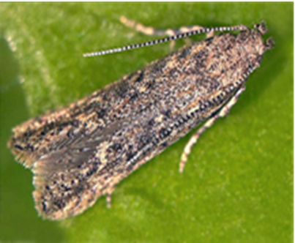
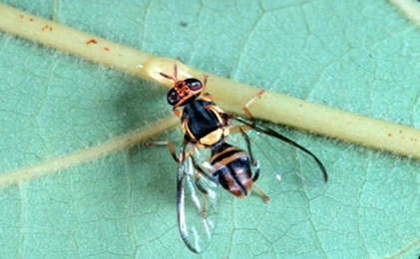
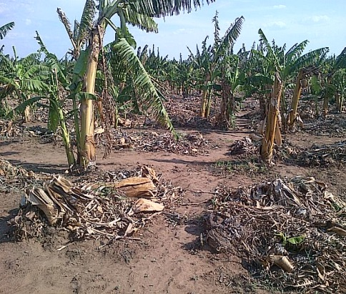
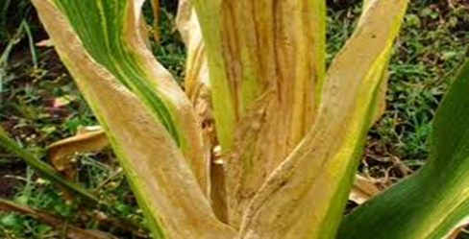
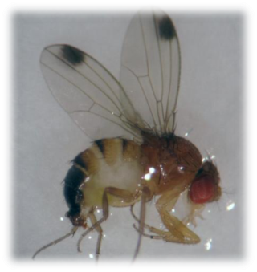
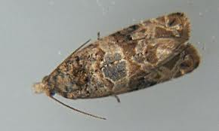
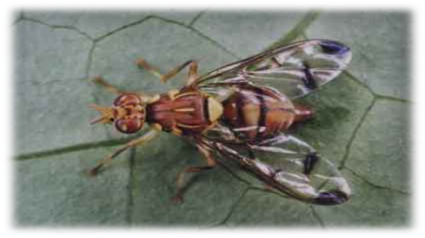
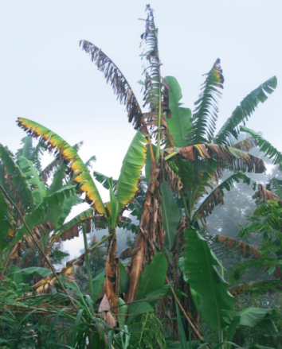
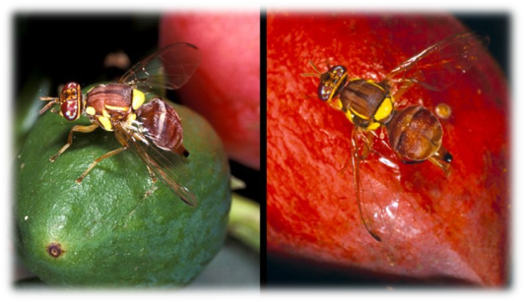
Challenges in the plant health environment …..
Tuta absoluta
Present in SA
Oriental fruit fly
Present in SA
Banana Bunchy Top Virus
Present in KZN
Maize lethal necrosis Reported in Tanzania
Melon fruit fly
Reported in Mozambique
Panama disease
Reported in Mozambique
Bactrocera zonata
Lobesia botrana
Drosophila susikii

Slide 17
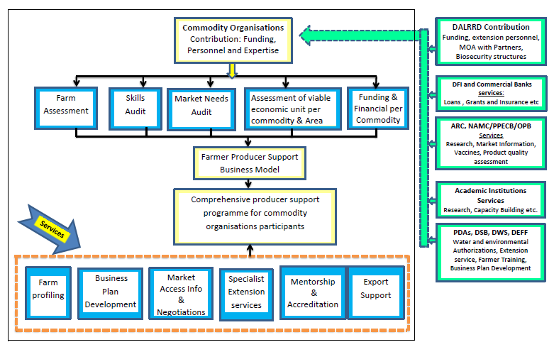
What is to be done?
Challenges
Solution Design
Current government farmer support programmes have not sufficiently focused on commercializing black producers.
Current producer support is fragmented, poorly coordinated and is not comprehensive for beneficiaries.
Black producers are largely not organized and remain excluded from the mainstream agricultural value chain.
Black producers have challenges in accessing markets, finance and technical supports and to link with integrated value chains and lack the skill and capacity to be competitive.
Further challenges facing producers include poor production and market infrastructure.
The initiative is a partnership between government, commodity organisations and other stakeholders to develop and provide a commodity-specific comprehensive producer support package for each black producer participating in the initiative.
17
Notes:
DALRRD will provide support and facilitate access to new markets, maintain and grow domestic and international markets by adhering to market standards.

Slide 18
What is to be done…..
Value Chains | Interventions and Opportunities
Red Meat | New markets [China] USA, Kuwait and Saudi Arabia
Grain | Grain/Livestock Value Chain interlinkages
Poultry | The Poultry Task Team Growth of the sector Export potential of the ‘white’ meat Transformation of the industry
Horticulture | Export prioritisation tool USA, China and Thailand engagements
Sugar | The impending Sugar Industry Task Team The opportunities to explore energy co-generation and biofuels
Wildlife | Bioeconomy Strategy The Game Meat Regulations New inclusion into the Animal Improvement Act Veterinary Strategy

Slide 19
Transformation in the sector
““We need to be genuine and deliberate in transforming this sector.”
- Minister Thoko Didiza 16 – 07 - 2019
Engaging South Africa’s trading partners to increase exports of those products for which South Africa has comparative advantage;
Developing of an agribusiness master plan for the country;
Relooking how government could better enable the growth and competitiveness of the local poultry industry;
Preparing South African agribusinesses for the implementation of the Africa Continental Free Trade Area agreement.

Slide 20
Marking of containers and outer containers ……………
Producer name or trademark name
Details of the parker
Total Number of Eggs
Best before Date
Class& Size
Eggs/Free Range Eggs/Barn Eggs
Country of origin

Slide 21
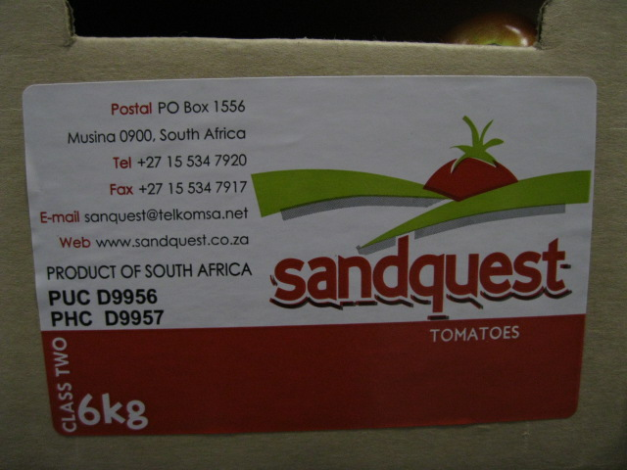
Marking Requirements for fresh vegetable produce
Packing date
Pack date: 643356
Physical or postal address
Country of origin
Name or trademark
“Optional’’
In local markets
Class
Name of product
Net mass/ weight

Slide 22
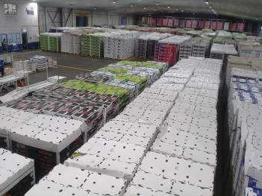
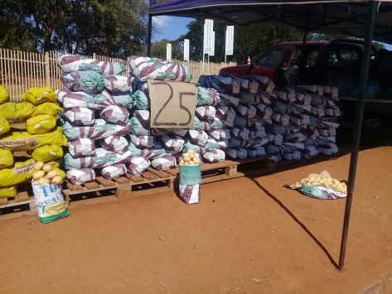
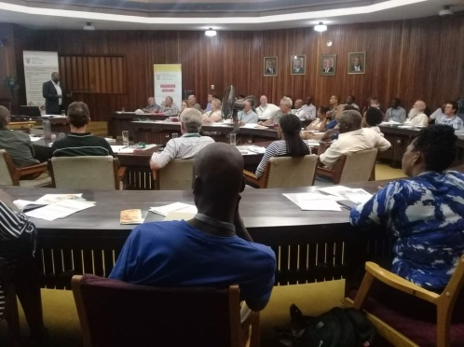
Mr Mpho Sekgala
Deputy Director: Biosecurity Promotions and Awareness
Enquiries: Tel : 012 319 6295/ 6004, 6475, 6118
INFO.SPS@Dalrrd.gov.za / MphoS@Dalrrd.gov.za , PriscillaMP@Dalrrd.gov.za RendaniTh@Dalrrd.gov.za , ErnestN@Dalrrd.gov.za ,
Thank you!
19

